Slide 1
ISTANBUL TECHNICAL UNIVERSITY
BLG 632E - NEXT GENERATION WIRELESS NETWORKS
INSTRUCTOR: IRFAN ALI
STUDENT NAME: TUĞRUL YATAĞAN
STUDENT NUMBER: 504161551
HEADER-SPACE ANALYSIS PRESENTATION
June 7, 2017

Slide 2
Data plane network verification
Complex interaction;
Between multiple protocols on a switch/router.
Between state on different switches/routers.
Network owner can’t…
Observe all state.
Control all state.
Can host A talk to host B?
What are all the packet headers from A that can reach B?
Are there any loops in the network?
What happens if I remove this line in the config file?

Slide 3
Header Space Framework - 1
Ignore protocol dependent meaning of header bits and see it as a flat sequence of 0s and 1s.
Model a packet as a point in {0,1}^{L} space – The Header Space
SRC MAC
DST MAC
SRC IP
DST IP
Data
0101..1
1010..1
0010..0
0010..0
Header
Data
0101..11010..10010..00010..0
010xxx011..x001xxxxx01110
L

Slide 4
Header Space Framework - 2
Model all networking boxes as transformers of header space
Transfer Function:
Every region of Header Space, can be described by union of Wildcard
1101..00
3
1
Packet
Forwarding
1110..00
2
Match
Action
11xx..0x
+
Send to port 2 Rewrite with 1x01xx..x1
0xx1..x1
+
Send to port 3 Rewrite with 1xx011..x1

Slide 5
Transfer Function Examples
IPv4 Router
172.24.74.x Port1
172.24.128.x Port2
171.67.x.x Port3
1
2
3
Forwarding Behavior
Forwarding Behavior + Time to Live (TTL)
(h,1) if dst_ip(h) = 172.24.74.x
(dec_ttl(h),1) if dst_ip(h) = 172.24.74.x
T(h, p) =
(h,2) if dst_ip(h) = 172.24.128.x
T(h, p) =
(dec_ttl(h),2) if dst_ip(h) = 172.24.128.x
(h,3) if dst_ip(h) = 171.67.x.x
(dec_ttl(h),3) if dst_ip(h) = 171.67.x.x

Slide 6
Transfer Function Other Examples
Rewrite: rewrite bits 0-2 with value 101
(h & 000111…) | 101000…
Encapsulation: encap packet in a 1010 header.
(h >> 4) | 1010….
Decapsulation: decap 1010xxx… packets
(h << 4) | 000…xxxx
TTL Decrement:
if ttl(h) == 0: Drop
if ttl(h) > 0: h – 0…000000010…0
Load Balancing:
LB(h,p) = {(h,P1),…(h,Pn)}

Slide 7

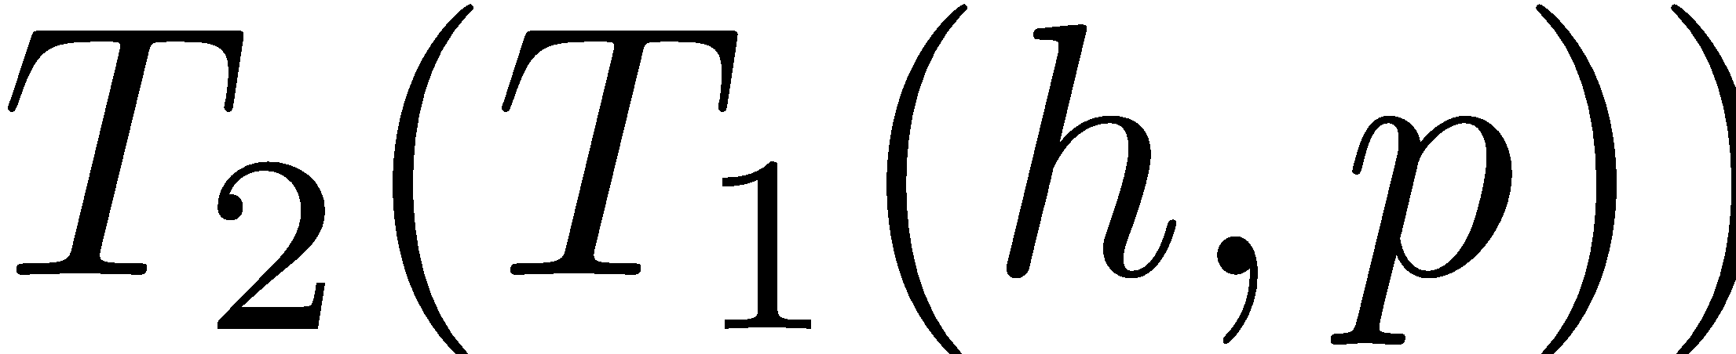
Transfer Function
By composing transfer functions, we can find the end to end behavior of networks.
R1
R2
R3
T₁(h, p)
Inverting transfer functions, gives all possible input packets that can generate an output packet.
T⁻¹(h,p)
Input Header Space
Output Header Space

Slide 8
Algorithms
Is there a loop in the network?
Inject an all-x test packet from every switch-port
Follow the packet until it comes back to injection port
T₁(X,P)
Box 2
T₂(T₁(X,P))
Box 1
Box 3
Original HS
Returned HS
Box 4
T₃(T₂(T₁(X,P)))
T₄(T₃(T₂(T₁(X,P))))
Also, finding reachability, checking isolation of slices, etc.

Slide 9
Implementations
Agent sits between the control plane and the switches, and it uses the Header Space Analysis algorithm that can be used to check a rule update against a single policy within very short time (50-500 us)
There are several well known HSA implementations;
Hassel
IP Table compression
Lazy subtraction
Dead object deletion
Lazy TE evaluation
Net-Plumber
Instead of recomputing all the transformations each time the network changes, it incrementally updates only the portions of those transfer function results affected by the change.

Slide 10
Thank you for listening!
References:
Mohammad Alizadeh, MIT 6.888 Lecture 16: Header Space Analysis
Nick Feamster, Data-Plane Verification: Header Space Analysis
P. Kazemian, M. Chang, H. Zeng, G. Varghese, N. McKeown, S. Whyte, Real time network policy checking using header space analysis
Ian F. Akyildiz, A roadmap for traffic engineering in SDN-OpenFlow networks

